Slide 1
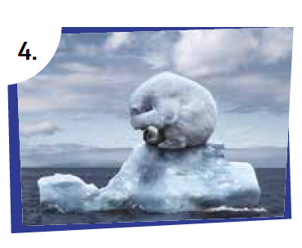
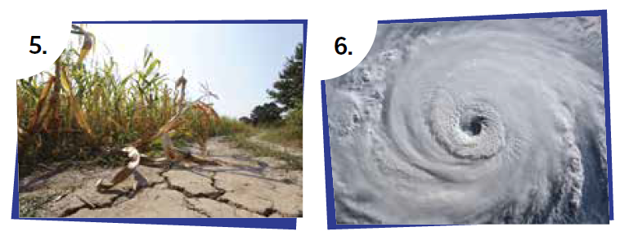
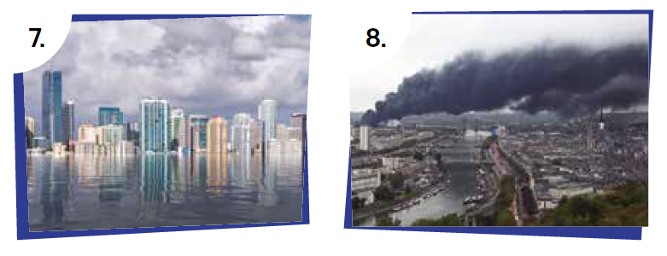
Humans and the Environment
deforestation
drought
flood
global warming
hurricane
pollution
rising sea level
wildfire
www.britishcouncil.org

