Slide 1
Events: International Women’s Day B2 – Upper intermediate
Adult English
March 2024

Slide 2
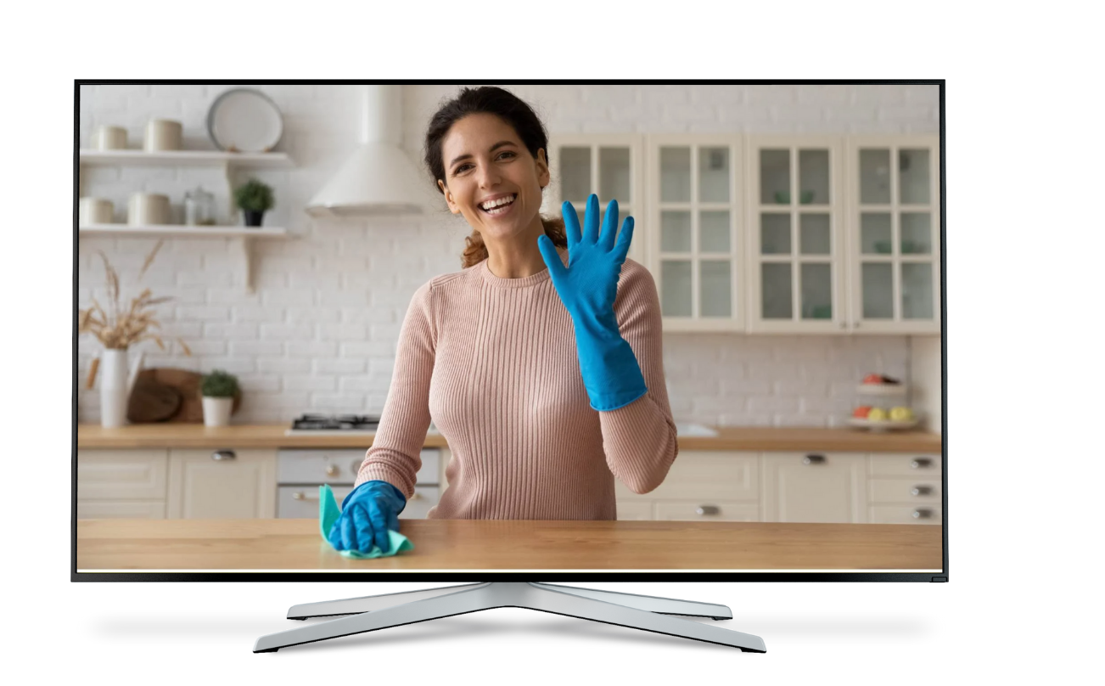
Is the representation of women in the media changing?
Learning objective:
Give your personal responses and convey emotion during a discussion
Women in the media
The representation of women in the media is undergoing a significant transformation, portraying women of various races, ages and body types more realistically. A growing number of women behind the scenes in the media, such as directors, producers and social media influencers, empower women to voice their own perspectives. This evolution is pivotal in promoting gender equality and empowering women and girls. International Women’s Day is an opportunity to reflect on progress that has been made, but also to discuss what further steps need to be taken.

Slide 3
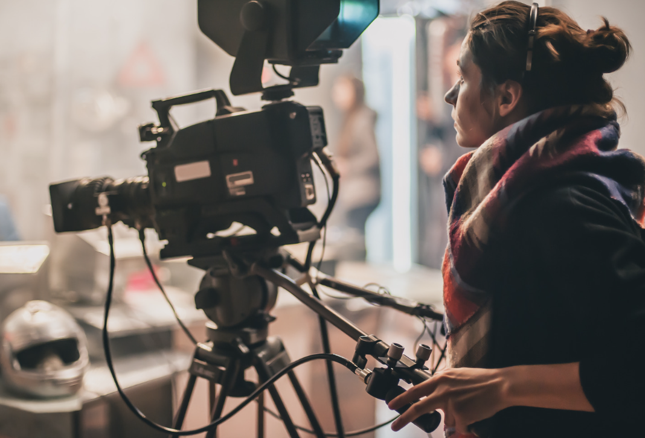
1. In groups, discuss the questions.
In the last 24 hours, what different types of media have you interacted with?
Did you notice anything about the way in which women were represented?

Slide 4
2. Read the quotes and discuss in groups.
What different challenges do the women in the film industry refer to?
How do you feel about what they say?
There are things that are really disappointing about being an actress in Hollywood that surprise me all the time. I do think that there's a lot of pressure on women to be 'ageless’.
Maggie Gyllenhaal, American actor
I felt driven to write about women the way we really are, as opposed to some man’s idea of what women are like – because the reality is that most women are still written by men.
Candace Bushnell, American author and producer
I started questioning gender-based assumptions when at eight I was confused at being called 'bossy' because I wanted to direct the plays we would put on for our parents, but the boys were not.
Emma Watson, UK actor, model and activist

Slide 5
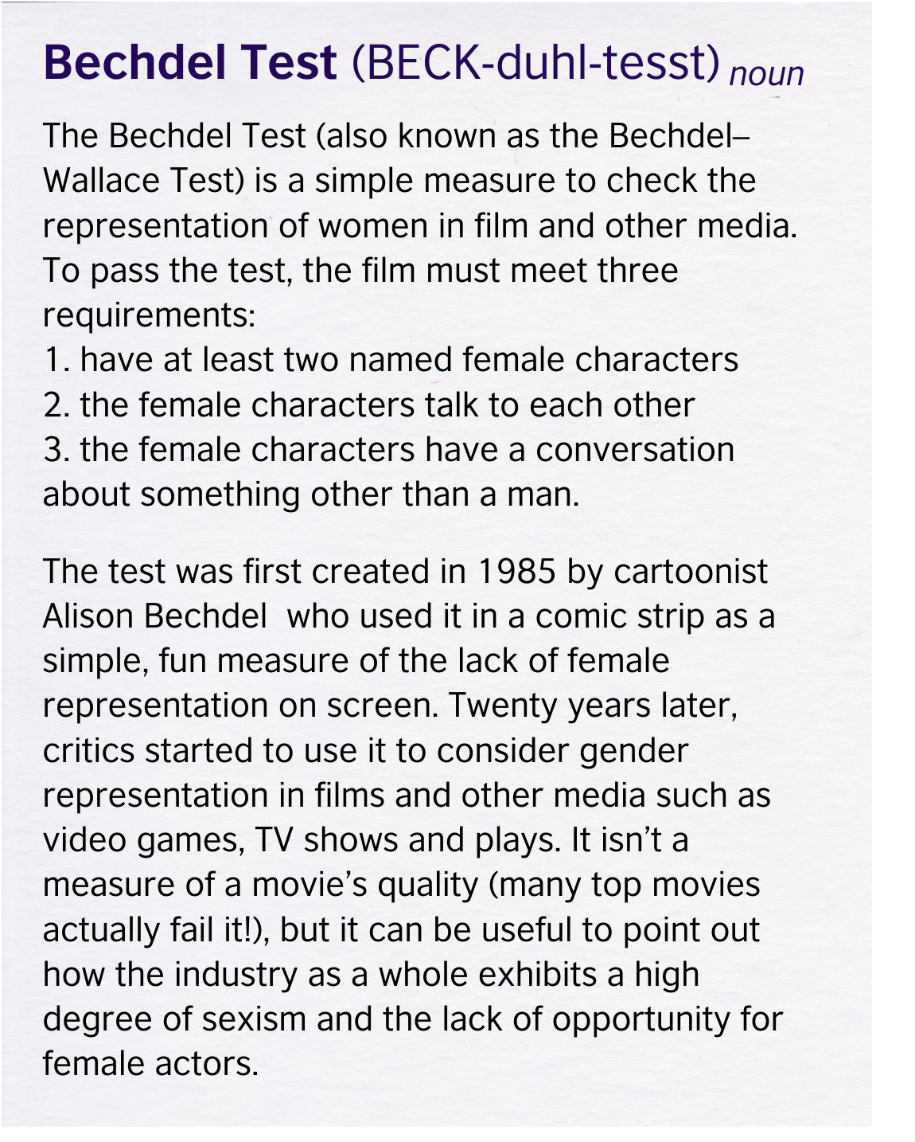
3. Read about the Bechdel Test. In pairs, discuss the questions.
Use the checklist to talk about the representation of women in a film you watched recently.
Do you think this is a valid way of testing a film?
What might some of its limitations be?

Slide 6
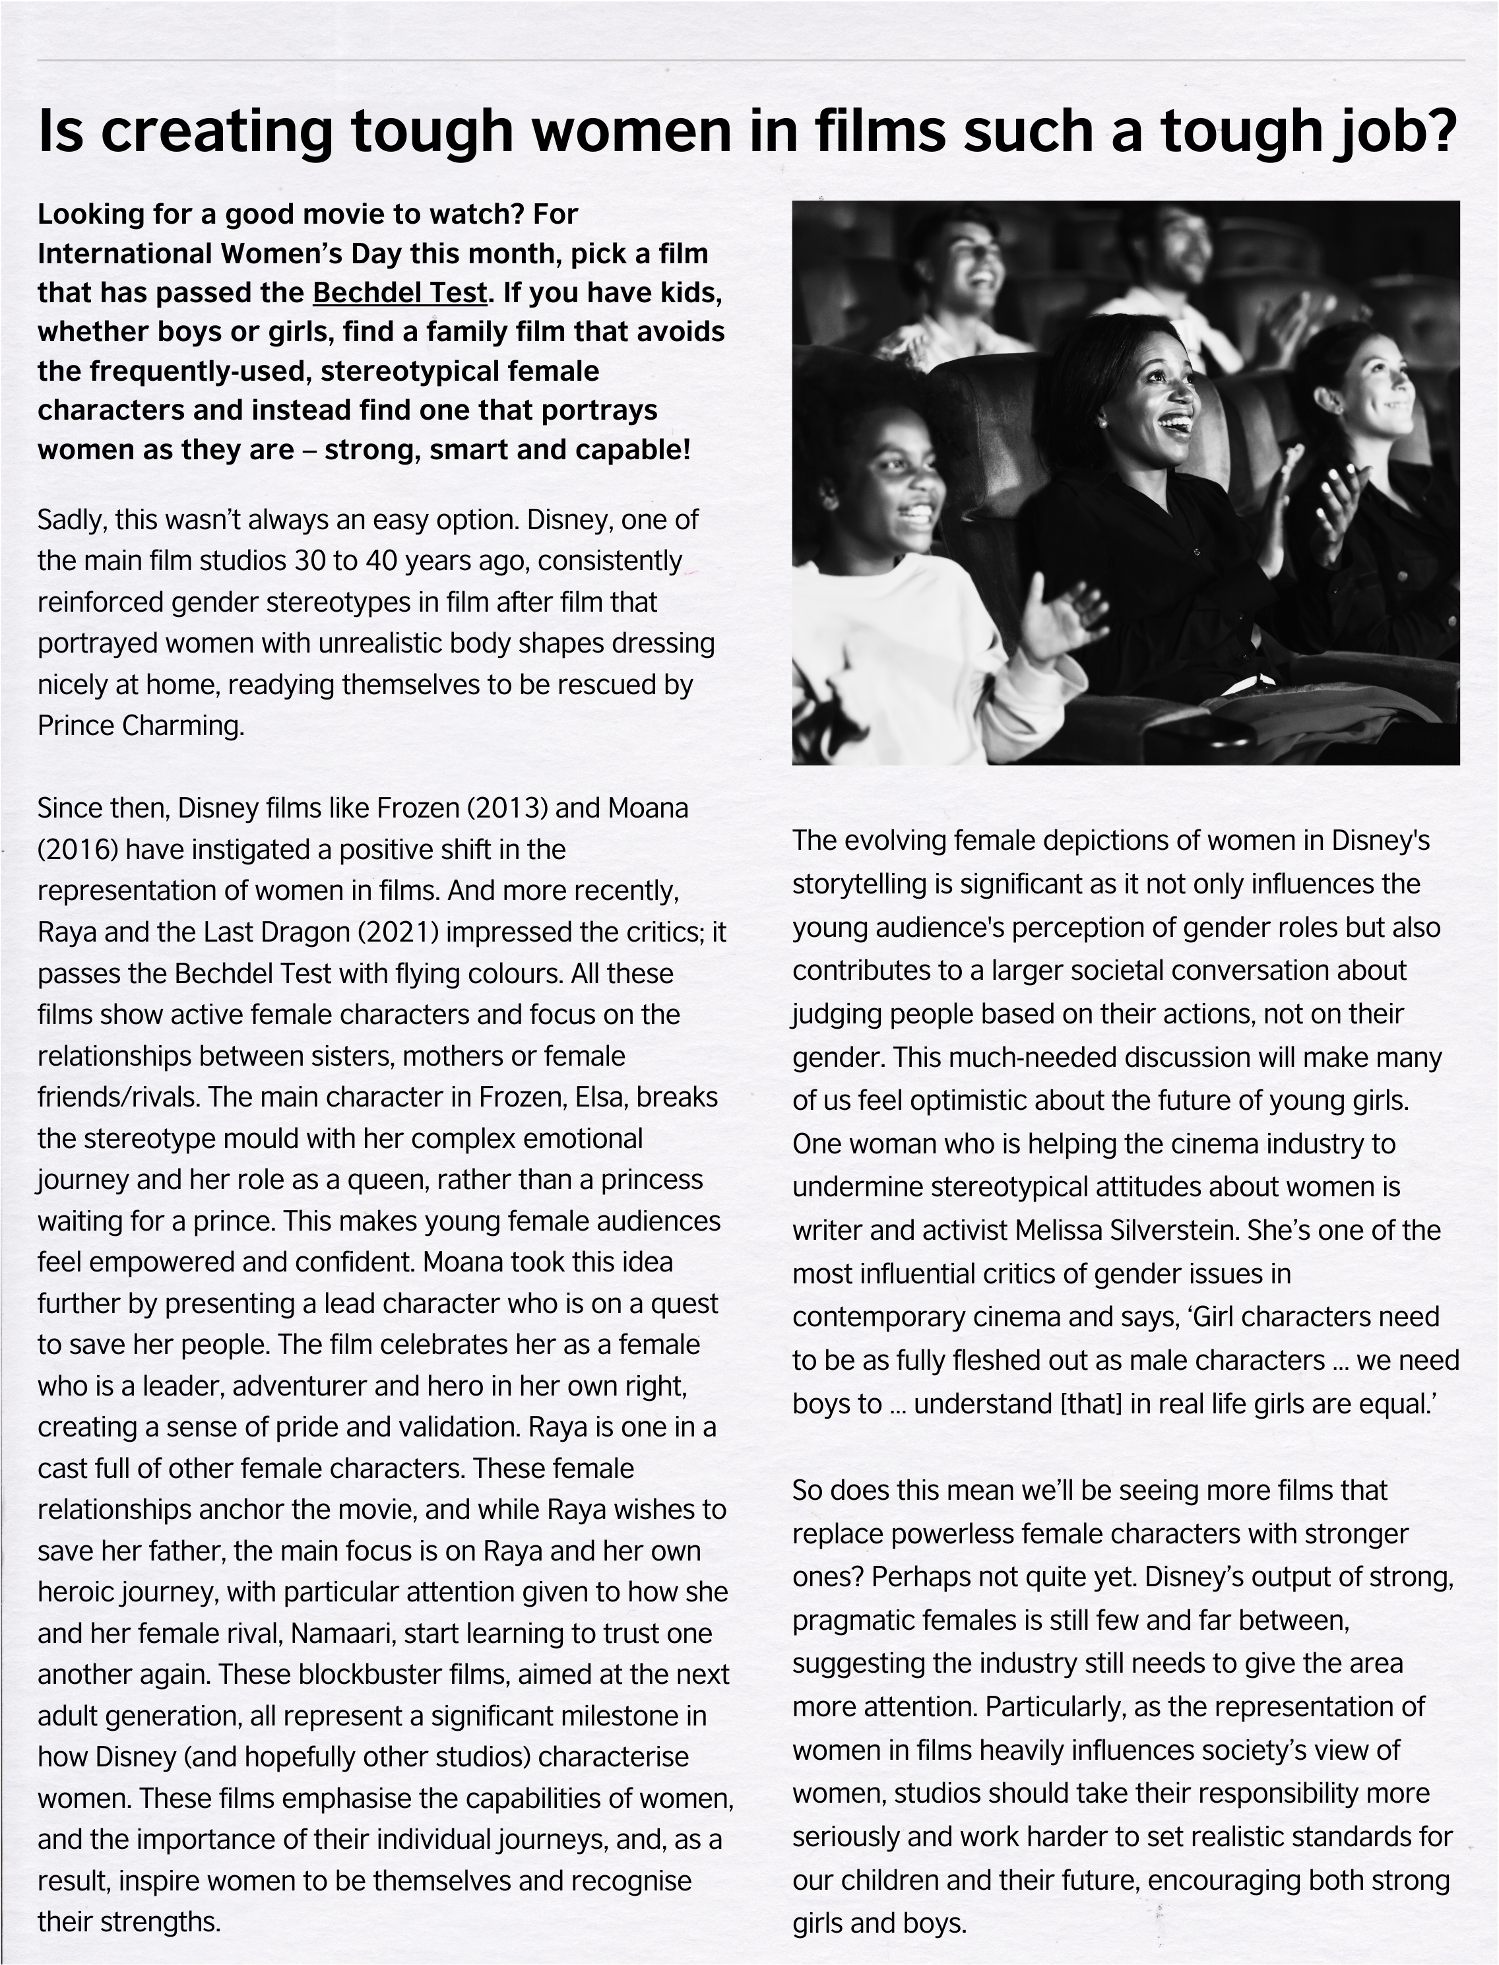
4. Read and discuss the magazine article.
The article mentions three Disney films that pass the Bechdel Test. What is it that these films do that ones in the past have often failed to do?
To what extent do you agree that children’s films are key to creating gender equality in the next generation? Give reasons?
Have you seen any films recently which have tried to break gender stereotypes? What did they do?

Slide 7
5. Look again at the article. Copy the table and record useful phrases you find for talking about the representation or lack of representation of women in the media.
Things we want media to do | Things we don’t want media to do
set realistic standards | reinforce gender stereotypes portray unrealistic body types

Slide 8
6. Two friends are talking about a TV show they watch set in a hospital. Read what they say with emotion.
This show really annoys me! It just reinforces gender stereotypes that women are nurses and men are doctors.
What a disappointment! They should have at least one female doctor to inspire women.
And the doctors speak to the nurses really slowly.
Effective communication
When discussing topics that you feel strongly about and which affect you personally, you will want to show emotion such as anger, frustration, disappointment, enthusiasm or sympathy. Adjusting your speech (tone, pitch, volume, intonation) can help you convey how you feel and engage your listeners on a deeper level.
That’s ridiculous!
They also portray unrealistic body types. Everyone in the show is six feet tall and thin. How crazy is that!
What a shame! It’s such a popular show. It’s not great representation.

Slide 9
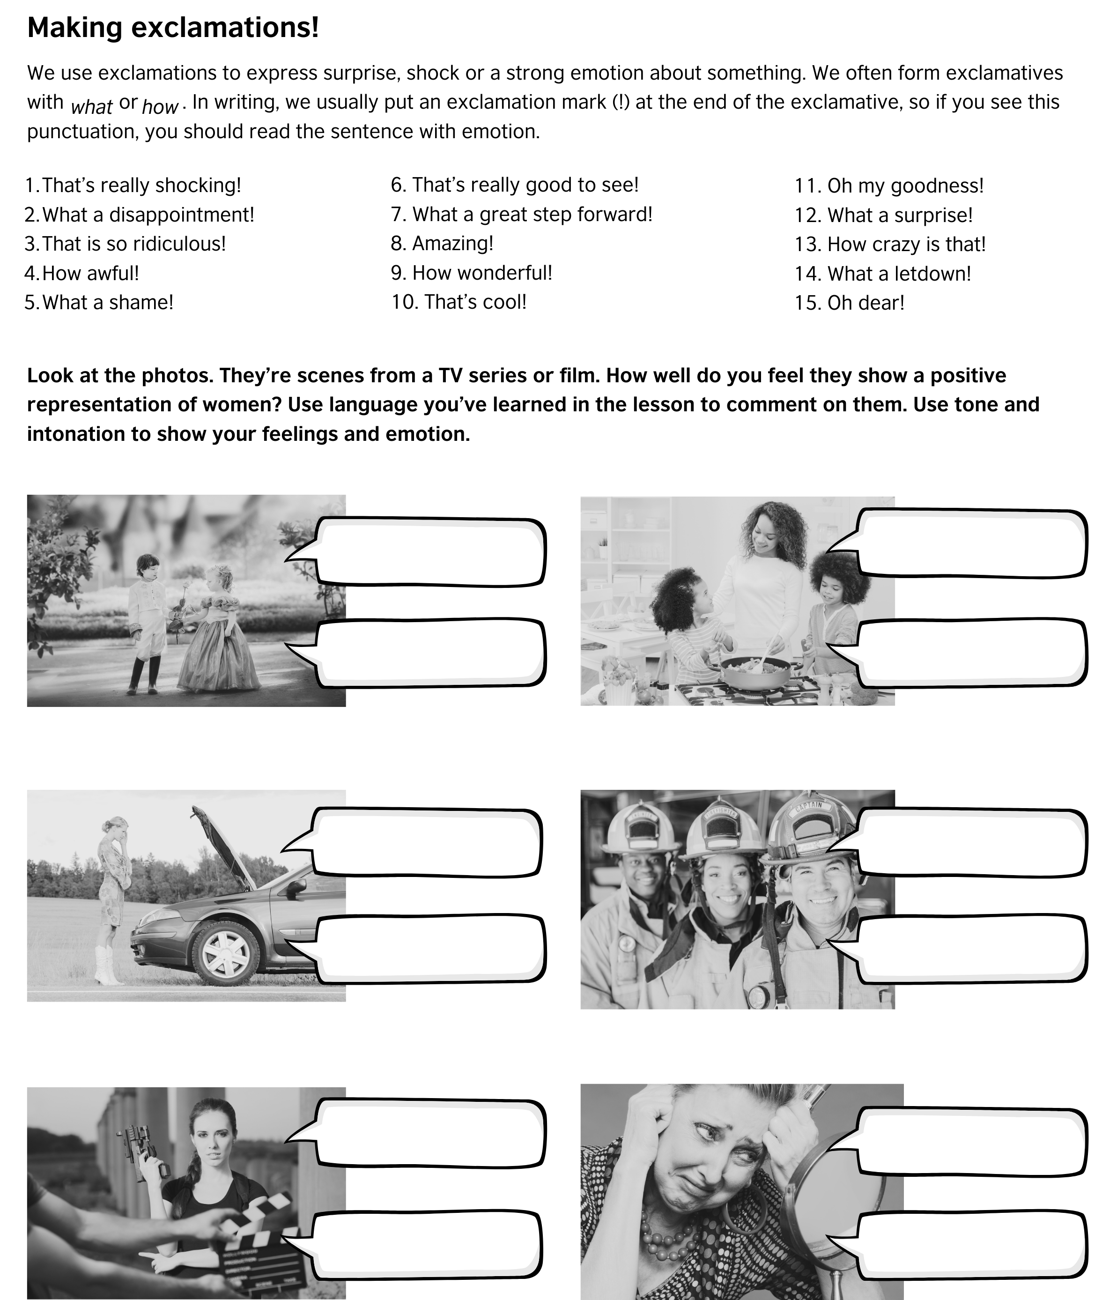
7. Look at the photos and react to what you see. Comment and share views about it.

Slide 10
Discussion ground rules
Ground rules set expectations and guide behaviour so that everyone feels comfortable in discussion.
Listen actively: give your full attention to the speaker.
Respect diverse perspectives: value and respect different opinions and experiences. Approach discussions with an open mind and a willingness to consider different viewpoints. Be receptive to new information and perspectives.
Confidentiality: respect the privacy and confidentiality of personal stories or experiences shared during discussions and avoid discussing or sharing information outside of the classroom without permission.
Participate equally: encourage equal participation by allowing everyone to speak and be mindful of not dominating the discussion.
No personal attacks: refrain from personal attacks, name-calling or disrespectful language.
Challenge ideas, not people: feel free to challenge ideas or opinions but avoid making it personal.
Use 'I' statements: express opinions using 'I' statements to take ownership of your perspective. Avoid speaking on behalf of an entire group.
No judgement zone: create a non-judgemental space where individuals feel safe expressing themselves.
Mobile phone etiquette: show others respect by silencing mobile phones or electronic devices during discussions.
Encourage quiet participants: actively encourage quieter peers to share their thoughts.

Slide 11
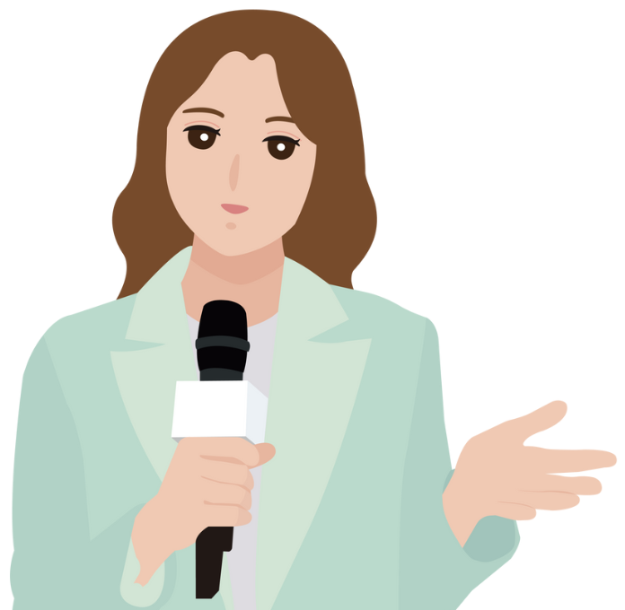
QUESTIONS FOR DISCUSSION
In pairs or small groups, choose and discuss the questions using your own experiences and emotions.
Thinking back to your childhood, how much did the representation of women in the media influence your ambitions, opinions and choices?
Are we seeing positive changes in the representation of women in media, or are women still facing resistance and challenges within the industry?
To what extent has any changes in the representation of women changed your feelings, opinions and choices now?
In what way do you think the representation of women in the media will change in the next ten years?
Can you think of any examples where stereotypes have been challenged or broken by the media (e.g. TV series, film, advert) in your country?
Are the efforts towards diversity and inclusion in the media industry genuine, or are they merely gestures to keep the public happy?
How can people (consumers of the media) avoid being manipulated by the media and not internalise the messages being conveyed about girls and women?
What is the importance, for you and for others, of having more women in media production roles (like directors, writers, etc.)?
Can you name some positive female role models in today's media? What makes them positive?
Do women in media have a moral obligation to use their platforms for advocacy and social change, or is it unfair to expect them to carry the burden of representation?
‘I want to give women a space to feel their own strength and tell their stories. That is power.’ – Beyoncé

Slide 12
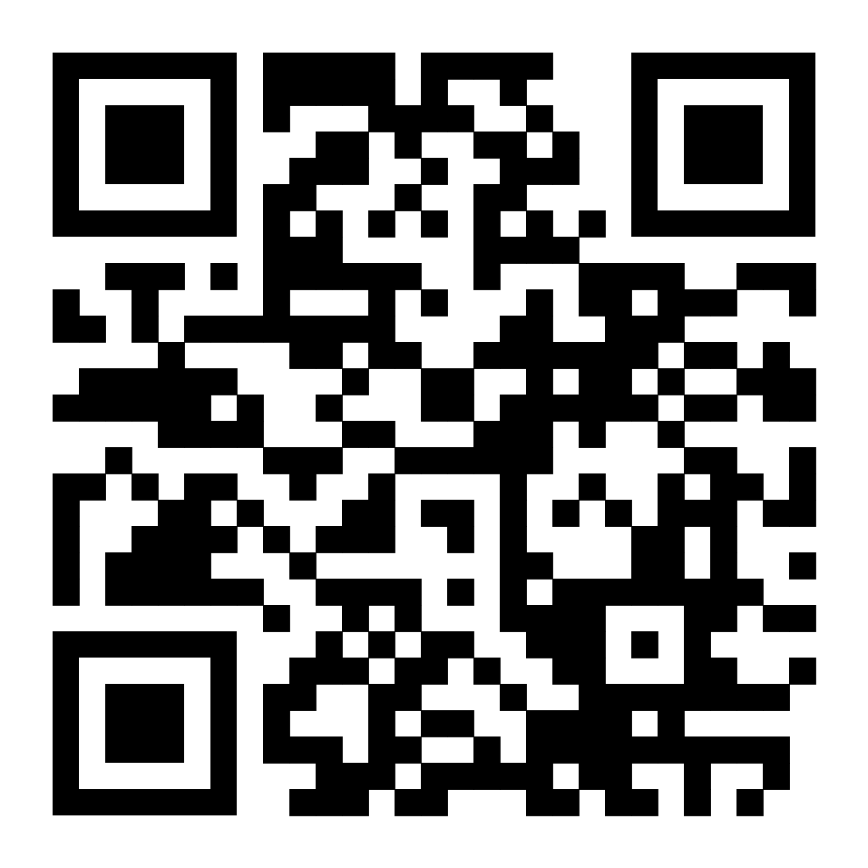
What can you do now?
Find more learning materials about this topic on our LearnEnglish website: www.britishcouncil.org/learnenglish
Listen to a podcast about this topic in our LearnEnglish Podcast app: https://uqr.to/pod2024
Go to the community: www.facebook.com/groups/britishcouncilenglishclub
join a live lesson this week
find a post about this topic and leave a comment
make your own post about the topic and interact with the members when they comment on your post
go along to the Friday Conversation Club and discuss the topic of the week

